Slide 1
Assessment 3
Animated Walk Cycle
Asish Sharma

Slide 2
Introduction
Introduction:
You will now be beginning your Third assessment. In this Assessment you will be planning, gathering reference for and animating a walk cycle.
The assessment will include:
Discussing and researching animation techniques.
Discussing and establishing what rig you will be using for your animation and how this will affect your animation.
Application of the basic principles of animation.
Understanding of basic camera techniques
An animated walk cycle using the rig of your choice.
A render of your walk cycle (This can be a playblast)
A completed post mortem
The assessment instructions:
All sections marked in green must be edited/filled out by each student. Be sure to replace “Student Name” on the first slide and the in the document title with your name.

Slide 3
Brief|Overview & Requirements
Overview:
You will be creating an animated walk cycle. You will need to use the character provided for the animation.
These are either the MAX rig or the Ultimate Bony rig
The assessment will involve 3 parts. These are:
planning:
You will need to gather reference for your animation.
Production:
An animated and rendered walk cycle.
Questions / post mortem:
A series of questions that will wrap up the assessment.

Slide 4
Task|Gather Reference - Trailer links
Using YouTube, Vimeo or any other video streaming service gather a minimum of 3 references of walking animations that you can use as reference. These walking animations can be from films, games, tv shows, whatever you think will be best for your reference.

Slide 5
Gather reference|Walk Cycle
Reference links and names
E.g. https://youtu.be/hldCtjT9baI - CGI VFX Showreels HD: "Assassin's Creed III Demo Reel" by Jonathan Cooper
https://www.youtube.com/watch?v=k86w0zlzY54 – “Walk Cycles Compilation” by Francis Jasmin
https://www.youtube.com/watch?v=GdaIZABMj98 - The Legend of Zelda – “Animation Project - Walk Cycle” by REE ANIMATION

Slide 6
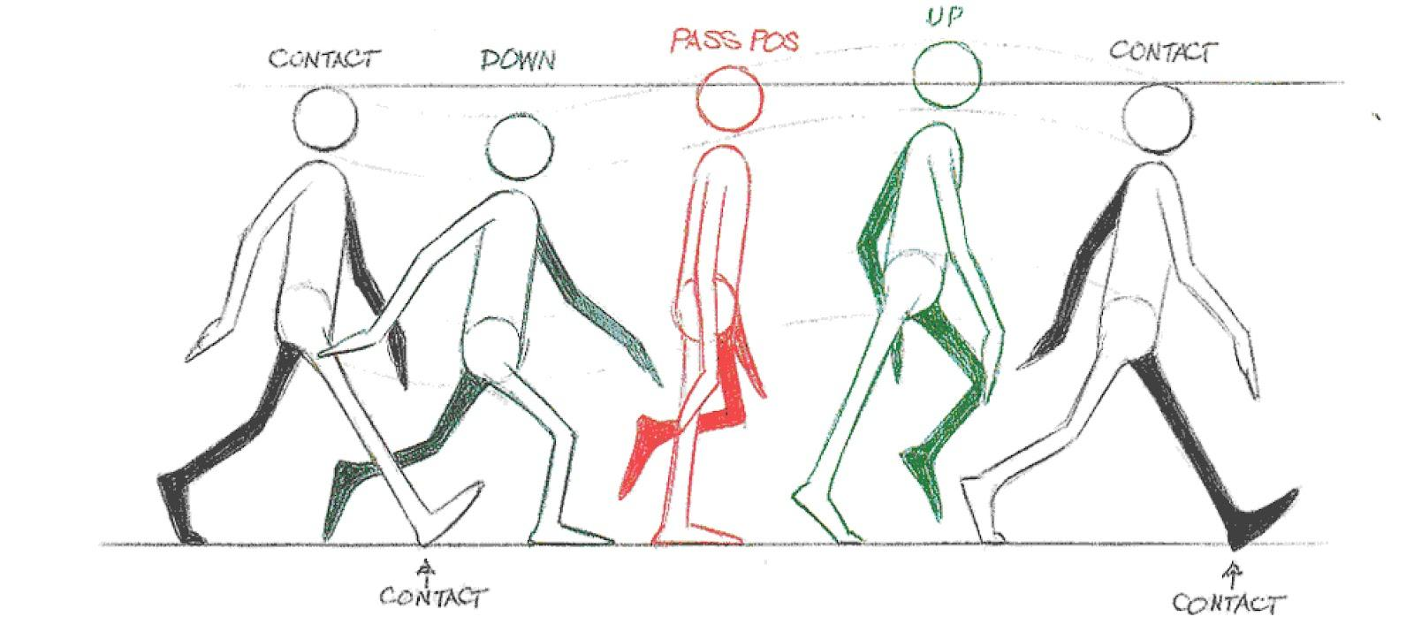
Task|Begin Walk Cycle
Now that you have reference you can now begin to animate your walk cycle.
To help you out I would suggest using the Walk Cycle Animation Google slide.

Slide 7
Task|Submission and presentation
Once you have completed your animation you will need to get it approved by your teacher.
Once it is approved you will need to present it to your class in order to receive feedback and answer questions given by your teacher.
After you have completed your presentation go to the post mortem slide and work through the post mortem questions.

Slide 8
Task|Post Mortem
Post Mortem Tasks:
Answer all the questions in the post mortem slide below.
Requirements:
All questions must be answered in sentences (25 Words).
Be sure to check your spelling, grammar and punctuation.

Slide 9
Post Mortem
Did the animation turn out as you expected?, If so how is it different?
Yes the animation turn out as I expected.
What was challenging in its creation?
The challenging in creation was animation not being smooth.
What are you most proud of about your animation?
I'm most proud of my walk cycle with smooth frame in my animation.
What would you do differently?
I would try to match the animation to the walk cycle reference as much as possible.
What new skills / things did you learn?
New skills I learnt were:- Animating, changing render settings/Frames Per Second(FPS), learnt the new tools/hotkeys.

Slide 10
Feedback|Final
Obtain approval for the final deliverables of the assessment.
Feedback | Approved

